Slide 1
Exploratory Factor Analysis Principal Component Analysis
Chapter 17

Slide 2
Terminology
Measured variables – the real scores from the experiment
Squares
Latent variables – the construct the measured variables are supposed to represent
Not measured directly
Circles

Slide 3
Factors and components
Factor analysis attempts to achieve parsimony by explaining the maximum amount of common variance in a correlation matrix using the smallest number of explanatory constructs.
These ‘explanatory constructs’ are called factors.
PCA tries to explain the maximum amount of total variance in a correlation matrix.
It does this by transforming the original variables into a set of linear components.

Slide 4
EFA vs PCA
Common variance = overlapping variance between items (systematic variance)
Unique variance = variance only related to that item (error variance)
EFA = describes the common variance
PCA = describes common variance + unique variance

Slide 5
EFA vs PCA
Communality – the common variance for the item
You can think of it as SMC: Squared multiple correlation
Created by using all other items to predict that item

Slide 6
Communality = 1
Variance of
Variable 3
Variance of
Variable 1
Variance of
Variable 2
Communality = 0
Variance of
Variable 4

Slide 7
R-Matrix
In Factor Analysis and PCA we look to reduce the R-matrix into smaller set of dimensions.

Slide 8
EFA vs PCA
EFA factors cause answers on questions
Want to generalize to another sample
PCA questions cause components
Want to just describe this sample
Drawing here
Therefore, EFA is more common in psychology

Slide 9
Uses of EFA/PCA
Understand structure of set of variables
Construct a scale to measure the latent variable
Reduce data set to smaller size that still measures original information

Slide 10
Graphical Representation

Slide 11
Before you start
Sample size suggestions
10-15 participants per item
<100 is not acceptable
ARGUE LOTS OF MONTE CARLOS!
300 is the most agreed upon best bet

Slide 12
Before you start
Sampling adequacy – do you have a large enough sample?
Kaiser-Meyer-Olkin (KMO) test
Compares the ratio between r² and pr²
Scores closer to 1 are better, closer to 0 are bad
.90+ = yay, .80 = yayish, .70 = ok, .60 = meh, .<.50 = eek!

Slide 13
Before you start
Number of items
You need at least 3-4 items per F/C
So with a 10 question scale, you can only have 2 or 3 F/C
The more the better!
Need to be at least interval measurement

Slide 14
Before you start
Assumptions:
Accuracy, Missing
Outliers
(use Mahalanobis to find outliers for all items)
Linear (!!)
Normal
Homogeneity/Homoscedasticity

Slide 15
Before you start
What about multicollinearity?
You want items to be correlated, that’s the point but not too high cuz then the math gets screwy.
How to check if they are too small:
Barlett’s Test – if non-significant implies that your items are not correlated enough (bad!).
Not used very much because large samples are required, which usually makes small correlations significant

Slide 16
Questions to Answer
How many factors/components do I have?
Can I achieve simple structure?
Do I have an adequate solution?

Slide 17
1. # of Factors/Components
Ways to determine number to extract
Theory
Kaiser criterion
Scree Plots
Parallel Analysis

Slide 18
1. # of Factors/Components
Theory
Usually you have an idea of the number of latent constructs you expect
You made the scale that way
Previous research

Slide 19
1. # of Factors/Components
Kaiser criterion
Note this is sometimes still used, but usually not recommended
Old rule: extract the number of eigenvalues over 1
New rule: extract the number of eigenvalues over .7

Slide 20
1. # of Factors/Components
Eigenvalues:
A mathematical representation of the variance accounted for by that grouping of items
Confusing part:
You will see the number of eigenvalues as you have items because they are calculated before extraction
Only a few should be large

Slide 21
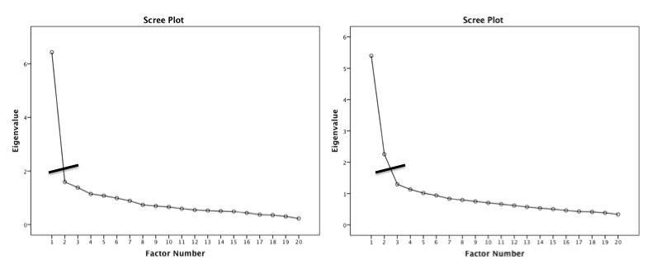
1. # of Factors/Components
Scree plot – a graphical representation of eigenvalues
Look for a large drop

Slide 22
Scree Plots

Slide 23
1. # of Factors/Components
Parallel Analysis – a statistical test to tell you how many eigenvalues are greater than chance
Calculates the eigenvalues for your data
Randomizes your data and recalculates the eigenvalues
Then compares them to determine if they are equal

Slide 24
1. # of Factors/Components
What to do if they disagree?
Test both models to determine which works better (steps 2 and 3)

Slide 25
2. Simple Structure
Fitting estimation = MATH that is used to determine factor loadings.
How to pick?
Depends on what your goal is for the analysis.

Slide 26
2. Simple Structure
EFA | PCA
Maximum Likelihood | Principal axis factoring
Alpha factoring | Image factoring
 | Principal components

Slide 27
2. Simple Structure
Rotation – rotation helps you achieve simple structure by increasing the communality between items
To aid interpretation: maximize the loading of an item on one F/C while minimizing its loading on all other F/C
Orthogonal
Oblique

Slide 28
Orthogonal
Oblique

Slide 29
2. Simple Structure
Orthogonal – assumes the F/C are uncorrelated
Rotates at 90º
Means no overlap in variance between F/C
Not suggested for psychology
Types
Varimax, quartermax, equamax

Slide 30
2. Simple Structure
Oblique – assumes some correlation between F/C
Rotates at any degree
Allows F/C to overlap
If F/C are truly uncorrelated, you get the same results as orthogonal
Types
Direct oblimin, promax
So why ever do orthogonal?

Slide 31
2. Simple Structure
Loadings – the correlation between that item and the F/C
What to look for:
Items to load over .300
Remember that r = .3 is a medium effect size that is ~10% variance
You can use higher loadings to help cut out low loading questions, but really can’t go lower.

Slide 32
2. Simple Structure
Loadings
You want each item to load on one and only one F/C
Double loadings = indicate a bad item
No loading = indicate a bad item

Slide 33
2. Simple Structure
Loadings
F/C with only one/two items loading onto it are considered unique
You should consider eliminating that F/C
Remember three or four items are suggested

Slide 34
2. Simple Structure
What to do if bad items?
In this step you might run several rounds
Find the bad items, run the EFA/PCA again without them
Cross loadings?
If there is a good theoretical reason, but generally not accepted

Slide 35
2. Simple Structure
Finished?
When all items have loaded adequately

Slide 36
3. Adequate solution
So how can I tell if that simple solution is any good?
Fit indices
Reliability
Theory

Slide 37
3. Adequate solution
Fit indices – a measure of how well the rotated matrix matches the original matrix
Two types:
Goodness of fit
Residual statistics

Slide 38
3. Adequate solution
Goodness of fit statistics – want large values, compares reproduced correlation matrix to real correlation matrix
Fit | Name | Good | Acceptable | Poor
NNFI/TLI | Non-normed fit index, Tucker-Lewis index | >.95 | >.90 | <.90
CFI | Comparative fix index | >.95 | >.90 | <.90
NFI | Normed fit index | >.95 | >.90 | <.90
GFI, AGFI = don’t use

Slide 39
3. Adequate solution
Residual statistics – want small values, look at the residual matrix (i.e. reproduced – real correlation table)
Fit | Name | Good | Acceptable | Poor
RMSEA | Root mean square error of approximation | <.06 | .06-.08 | >.10
RMSR | Root mean square of the residual | <.06 | .06-.08 | >.10

Slide 40
3. Adequate solution
Reliability – an estimate of how much your items “hang together” and might replicate
Cronbach’s alpha most common
.70 or .80 is acceptable
Split-half reliability for big datasets
Splits data in half, runs reliabilities, checks how similar they are

Slide 41
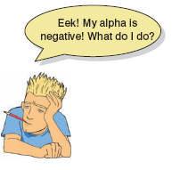
Interpreting Cronbach’s Alpha
Kline (1999)
Reliable if α > .7
Depends on the number of items
More questions = bigger α
Treat Subscales separately
Remember to reverse score reverse phrased items!
If not, α is reduced and can even be negative

Slide 42
3. Adequate solution
Theory
Do the item loadings make any sense?
Can you label the F/C?

Slide 43
The SAQ

Slide 44
FACTOR
We are going to use FACTOR, a free Windows program for EFA
It calculates fit indices
It calculates parallel analysis
It’s generally pretty awesome (minus the windows part)
It’s free!
On blackboard under exam 3 folder

Slide 45
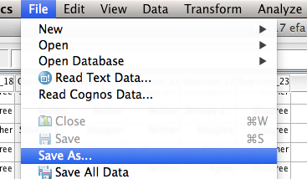
FACTOR
You need a .dat file to start.
Open the c17 efa SAQ.sav file.
File > save as

Slide 46
FACTOR
Change the drop down to Tab delimited .dat.
Save the file somewhere you can find it on the computer.
Make sure you note
Number of participants (rows)
Number of variables (columns)

Slide 47
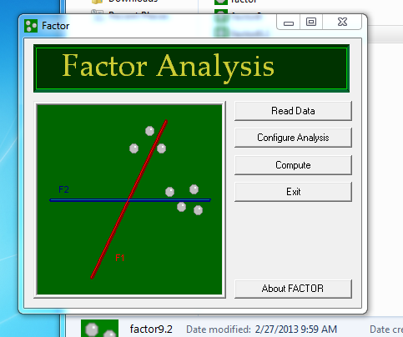
FACTOR
Open
FACTOR.

Slide 48
FACTOR
Hit read data.
Enter the number of participants.
Enter the number of variables.
Hit browse and find the .dat data file on your computer.

Slide 49
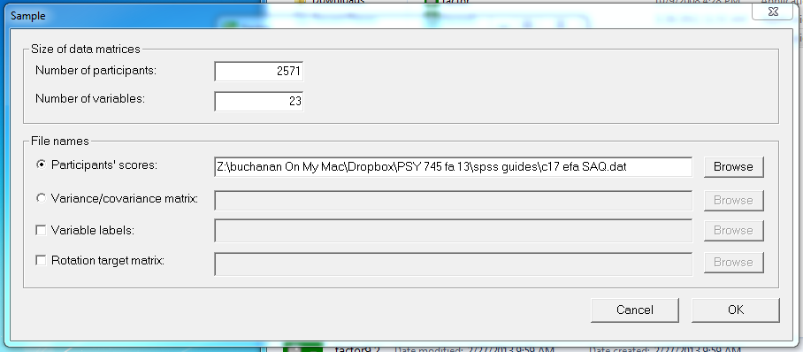
FACTOR

Slide 50
FACTOR
You should now see the Ready! message
You’ll get an error if you too many rows or columns, but not too little, so be sure to check your dataset first.

Slide 51
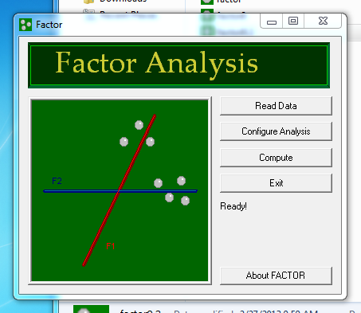
FACTOR

Slide 52
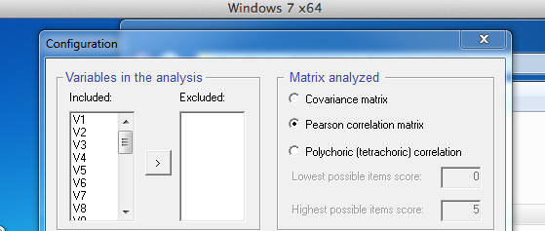
FACTOR
Hit configure analysis.
Variables in analysis – be careful … unlike SPSS things on the LEFT are included. So for the first round, you will leave them all on the left.

Slide 53
FACTOR
Matrix analyzed – leave this alone for real data, but if you have dichotomous data, you can use polychoric correlations

Slide 54
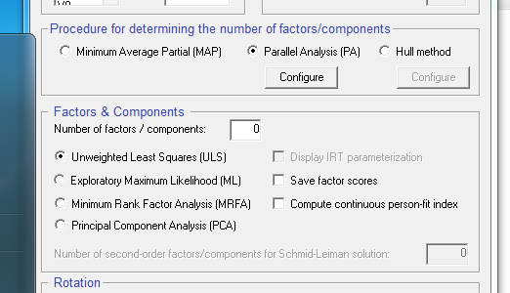
FACTOR
Parallel analyses are in the middle, PA is suggested.

Slide 55
FACTOR
Factors and components
Number of factors and components – for the first round (when you are trying to see the parallel analysis and scree plot), just put in 1 or 2 to get it to run.
On your real versions, put in the number of factors expected.
Fitting solution options are below.
We are going to use ML for EFA, but MRFA or ULS are also good options if you can’t get ML to run.

Slide 56
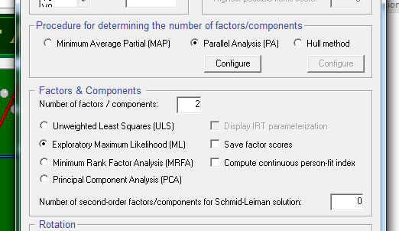
FACTOR

Slide 57
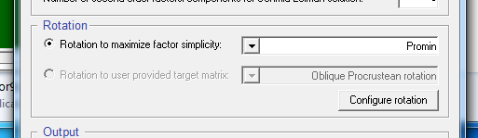
FACTOR
Rotation – many different rotation options for you to select from
Normalized direct oblimin is the most common option for EFA with oblique
(it also matches mathematically with SPSS direct oblimin).

Slide 58
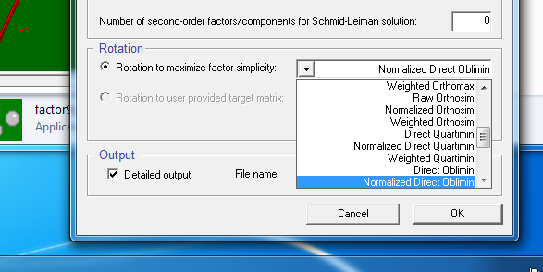
FACTOR

Slide 59
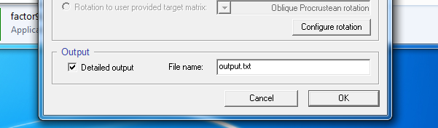
FACTOR
Output – you can name the output by round to make sure you save all the files (otherwise they overwrite each other).
It saves in the same directory as the data file.

Slide 60
FACTOR
Hit compute!
Don’t touch anything!
It will act like it’s frozen, but just wait.

Slide 61
FACTOR
In the word file:
Descriptives (means, sd, skew, kurtosis)
Multivariate skew/kurtosis
Correlation table
KMO test – remember you want high values
Barlett’s test – remember you want significant values

Slide 62
FACTOR
Eigenvalues are next
You can look at all the different criterions here:
Theory – didn’t really know?
Kaiser – 4 – 10 factors
Do we really have enough questions for 10?
To get scree plot, you have to use Excel to plot them (or SPSS).

Slide 63
FACTOR

Slide 64
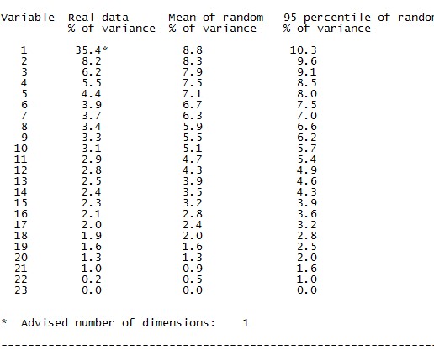
FACTOR
Scree plot indicates it’s either two or four.
Parallel analysis next in output – suggests 1.

Slide 65
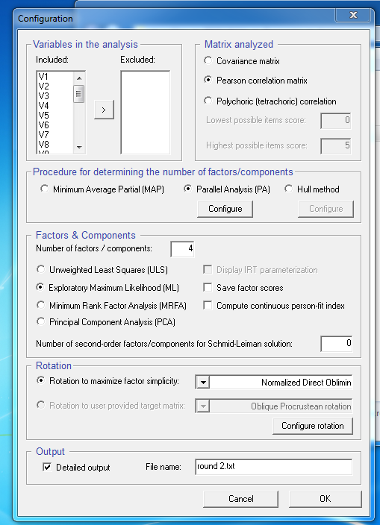
FACTOR

Slide 66
FACTOR
(let’s try four so that you can see what “bad questions” are like).
For real data, you might try 1, 2, and 4 to see which makes the most sense (step 3).

Slide 67
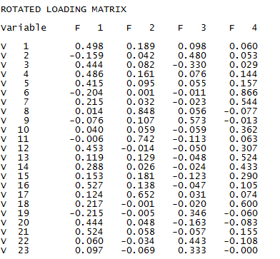
FACTOR
Since we are now working on simple solution, scroll down to the ROTATED MATRIX.

Slide 68
FACTOR
Do not look at the unrotated matrix.
Right below the unrotated matrix, is one with small coefficients left off.
Be sure you look at the other one because they actually leave off the .300

Slide 69
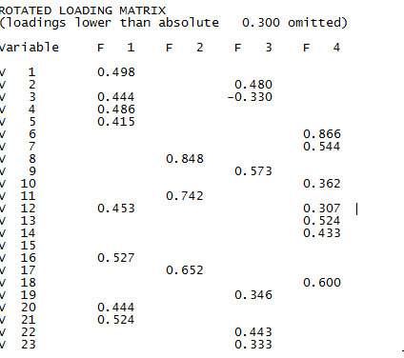
FACTOR

Slide 70
FACTOR
Look for blank lines
Look for ones with more than 2 loadings
“Bad” questions
3, 12, 15

Slide 71
FACTOR
Rerun the whole thing without those questions.
Hit configure analysis, move those questions to the right.
Note, control clicking the variables actually moves everything in between over…so you might have to do them one at a time.

Slide 72
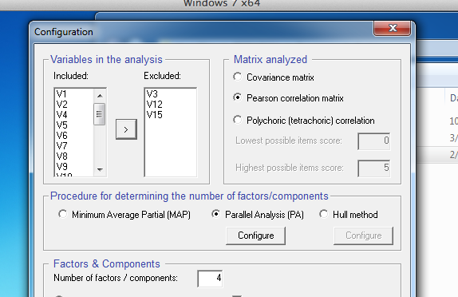
FACTOR

Slide 73
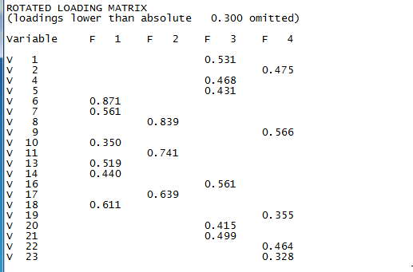
FACTOR
Second round

Slide 74
FACTOR
Now all the questions load onto one and only one factor!

Slide 75
FACTOR
6 | 0.871 | -0.007 | -0.196 | 0.007
7 | 0.561 | 0.021 | 0.205 | -0.022
10 | 0.350 | 0.047 | 0.062 | -0.058
13 | 0.519 | 0.140 | 0.095 | -0.073
14 | 0.440 | 0.021 | 0.274 | -0.033
18 | 0.611 | 0.001 | 0.192 | -0.036
8 | -0.073 | 0.839 | 0.028 | 0.053
11 | 0.066 | 0.741 | -0.004 | -0.116
17 | 0.078 | 0.639 | 0.137 | 0.027
1 | 0.063 | 0.160 | 0.531 | 0.081
4 | 0.157 | 0.153 | 0.468 | 0.060
5 | 0.161 | 0.075 | 0.431 | 0.039
16 | 0.099 | 0.107 | 0.561 | -0.056
20 | -0.069 | 0.048 | 0.415 | -0.191
21 | 0.173 | 0.051 | 0.499 | -0.089
2 | 0.042 | 0.035 | -0.134 | 0.475
9 | -0.013 | 0.106 | -0.071 | 0.566
19 | -0.069 | -0.005 | -0.197 | 0.355
22 | -0.094 | -0.036 | 0.056 | 0.464
23 | -0.002 | -0.069 | 0.096 | 0.328

Slide 76
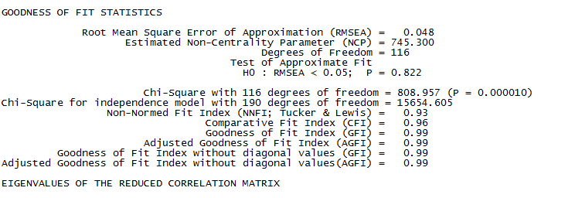
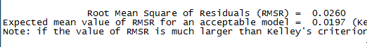
FACTOR
Adequate solution?

Slide 77
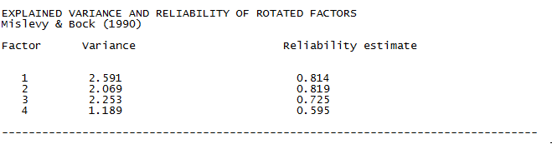
FACTOR
Cronbach’s

